Slide 1
Principles of Programming Language
Amit Dua
Computer Science and Information Systems Department
BITS, Pilani

Slide 2
Lambda Calculus
Lecture slides courtesy Prof. Sriram Rajamani

Slide 3
Progress
Lambda Calculus—Motivation
Syntax
Scope and binding
α-Renaming
β-Reduction
Call by value Vs call by name

Slide 7
Lambda calculus
From Wikipedia, the free encyclopedia
http://en.wikipedia.org/wiki/Lambda_calculus
In mathematical logic and computer science, lambda calculus, also λ-calculus, is a formal system designed to investigate function definition, function application, and recursion. It was introduced by Alonzo Church and Stephen Cole Kleene in the 1930s; Church used lambda calculus in 1936 to give a negative answer to the Entscheidungsproblem. Lambda calculus can be used to define what a computable function is. The question of whether two lambda calculus expressions are equivalent cannot be solved by a general algorithm. This was the first question, even before the halting problem, for which undecidability could be proved. Lambda calculus has greatly influenced functional programming languages, such as Lisp, ML and Haskell.
Lambda calculus can be called the smallest universal programming language. It consists of a single transformation rule (variable substitution) and a single function definition scheme. Lambda calculus is universal in the sense that any computable function can be expressed and evaluated using this formalism. It is thus equivalent to the Turing machine formalism. However, lambda calculus emphasizes the use of transformation rules, and does not care about the actual machine implementing them. It is an approach more related to software than to hardware.

Slide 8
Entscheidungsproblem
From Wikipedia, the free encyclopedia
http://en.wikipedia.org/wiki/Entscheidungsproblem
In mathematics, the Entscheidungsproblem (German for 'decision problem') is a challenge posed by David Hilbert in 1928.
The Entscheidungsproblem asks for a computer program that will take as input a description of a formal language and a mathematical statement in the language and return as output either "True" or "False" according to whether the statement is true or false. The program need not justify its answer, or provide a proof, so long as it is always correct. Such a computer program would be able to decide, for example, whether statements such as the continuum hypothesis or the Riemann hypothesis are true, even though no proof or disproof of these statements is known.
In 1936, Alonzo Church and Alan Turing published independent papers showing that it is impossible to decide algorithmically whether statements in arithmetic are true or false, and thus a general solution to the Entscheidungsproblem is impossible. This result is now known as the Church-Turing Theorem

Slide 22
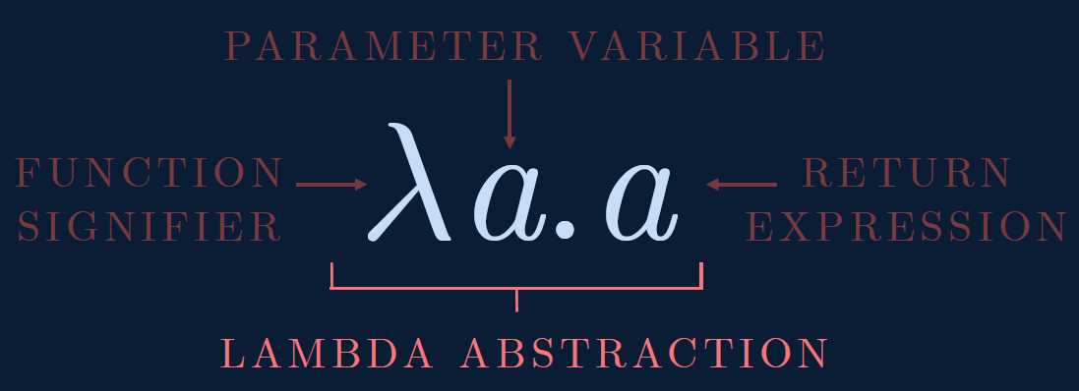

Slide 23
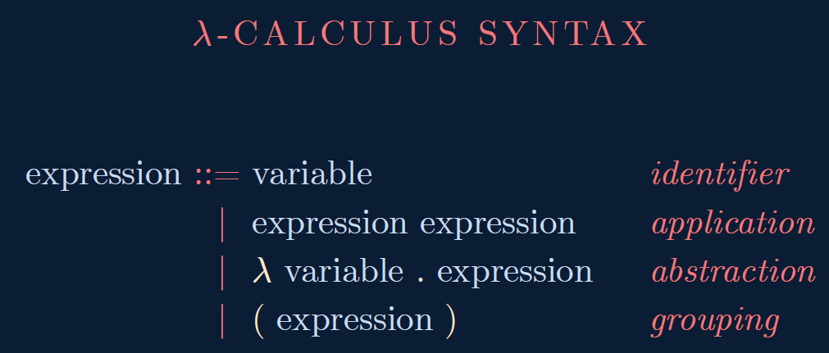

Slide 24
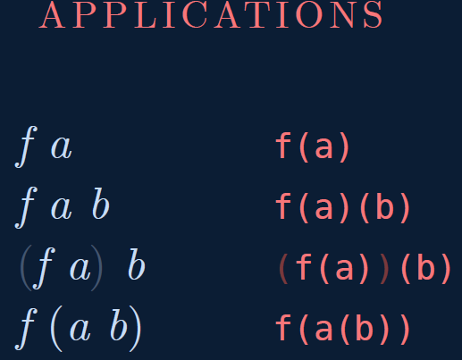

Slide 25
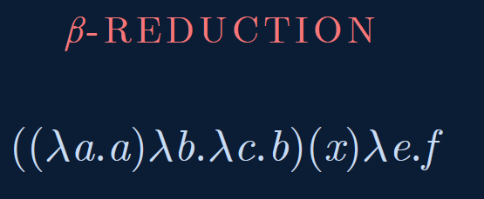

Slide 26
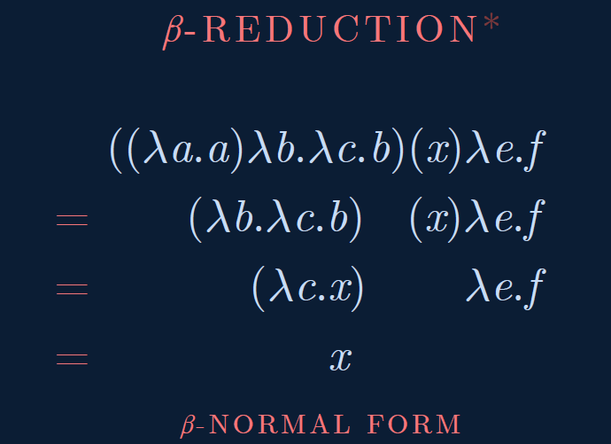

Slide 27
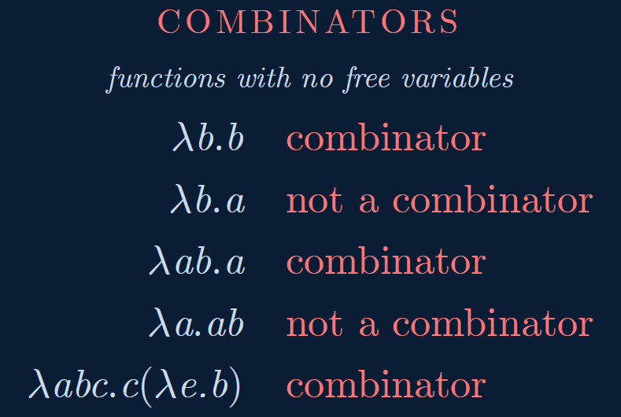

Slide 28
Haskell Example
fType :: Int -> Int -> Int
fType x y = x*x + y*y
main = print (fType 2 4)

Slide 29
Haskell Example
add :: Integer -> Integer -> Integer --function declaration
add x y = x + y --function definition
main = do
putStrLn "The addition of the two numbers is:"
print(add 2 5) --calling a function

Slide 48
Take away from today’s class
New programming language – Lambda calculus
Syntax
Scope
Renaming and Reduction
Call by value and name

Slide 49
Next class
How to express
Boolean expression
Numbers
addition
multiplication
recursion

